Slide 1
OBJECT DETECTION USING VISION TRANSFORMERS (VIT)
Group-31
Sai Manohar Vemuri: A20514848
Sesha Shai Datta Kolli : A20516330
Aditya Shivakumar : A20513537

Slide 2
ABSTRACT
Object detection is a crucial component in computer vision, essential for applications such as surveillance, autonomous vehicles, medical imaging, and content-based image retrieval.
Traditionally CNN's were used. They were useful in capturing local features, utilizing convolutional layers to extract hierarchies of patterns and structures, which improved the accuracy and efficiency.
A breakthrough in deep learning is the introduction of Vision Transformers (ViTs), which are seen as a promising alternative for various computer vision tasks.
Vision Transformers use self-attention to analyze complex relationships within an entire image, offering a comprehensive understanding of context, which enhances their effectiveness in computer vision tasks.

Slide 3
PROBLEM DESCRIPTION
The objective is to detect and localize objects of interest within images while achieving competitive performance compared to traditional CNN-based methods.
The main challenges include adapting the ViT architecture for object detection, managing various object sizes, and optimizing the model for computational efficiency.
ViTs represent a novel approach by applying a pure transformer model to images, dividing them into patches (treated as tokens), and using transformer blocks for encoding, leading to a final classification and object detection output.
For complex tasks ViTs need to maintain high input resolution to capture fine details, which presents a challenge due to the increased computational and memory demands.

Slide 4
DATASET
Dataset Name: Oxford-IIIT Pet Dataset
Dataset is a 37 category pet dataset with roughly 200 images for each class created by the Visual Geometry Group at Oxford.
Each image in the dataset comes with a set of annotations.
These annotations encompass valuable information, including:
The species and breed name of the animal depicted in the image
A meticulously delineated bounding box, precisely framing the head of the animal
A pixel-level segmentation, effectively distinguishing the foreground from the background, achieved through a process known as Trimap.

Slide 5
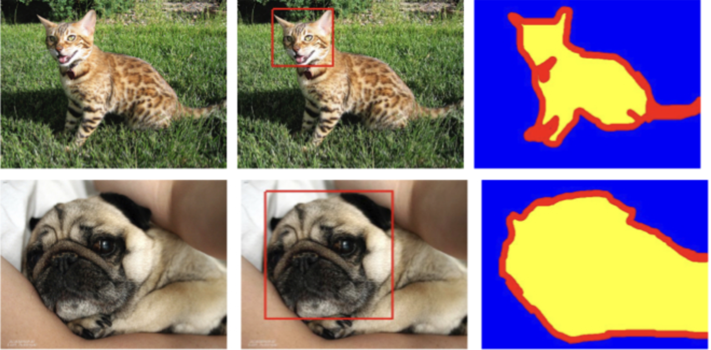
DATASET
EXAMPLES OF ANNOTATIONS

Slide 6
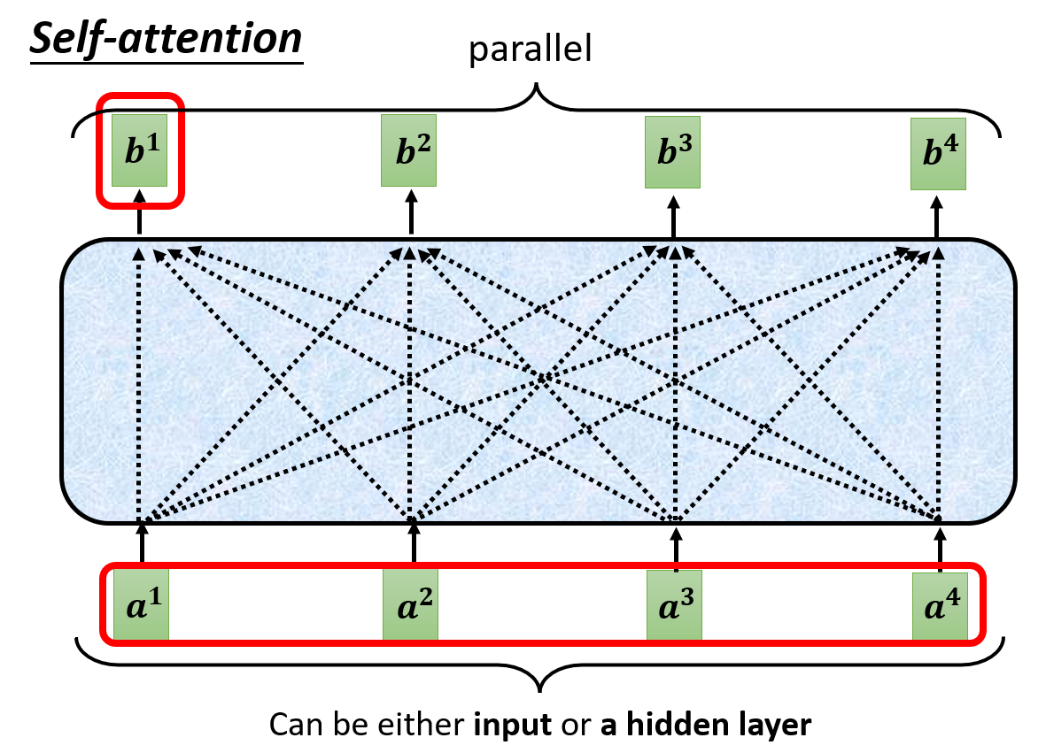
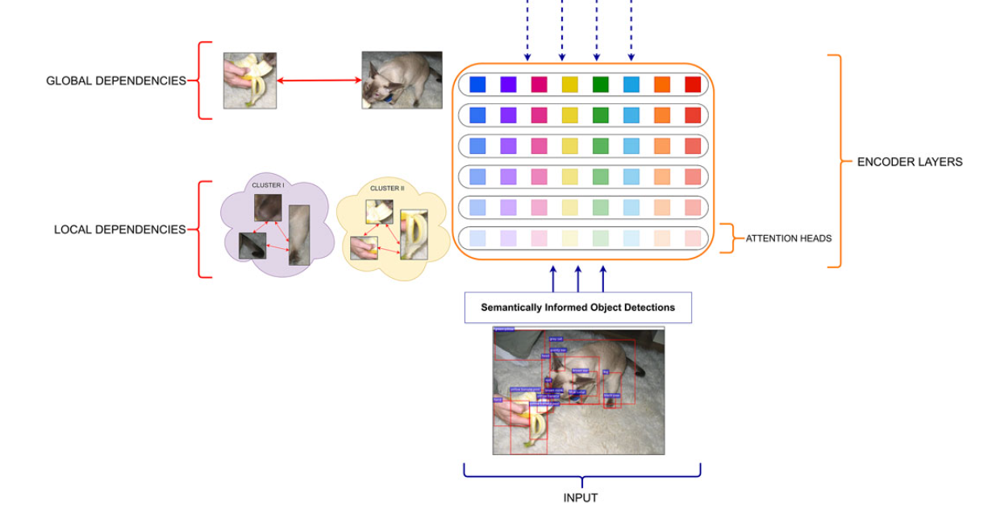
What are Transformers?
Transformers are a type of neural network architecture introduced in the natural language processing (NLP) domain.
Developed to overcome limitations in handling long-range dependencies in sequential data.
Core Concepts:
Self-Attention Mechanism:
Attention Heads:

Slide 7
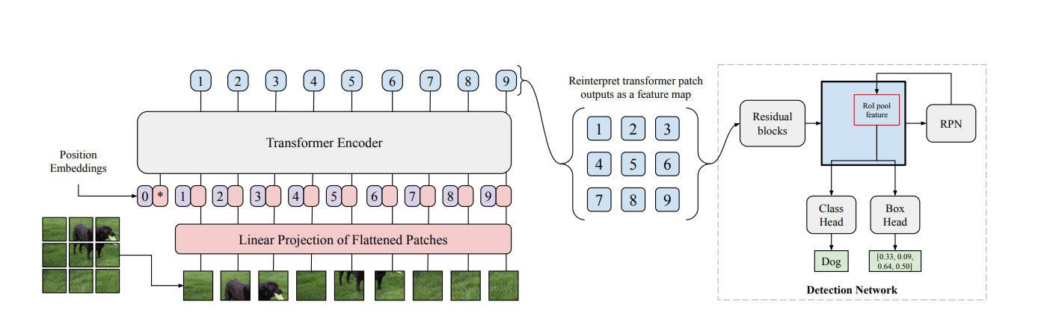
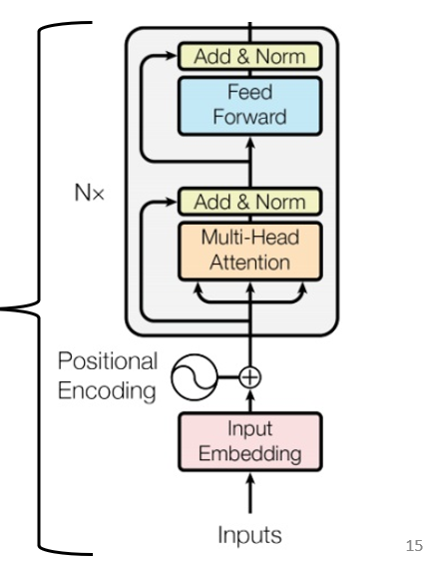
Vision Transformers (ViT)

Slide 8
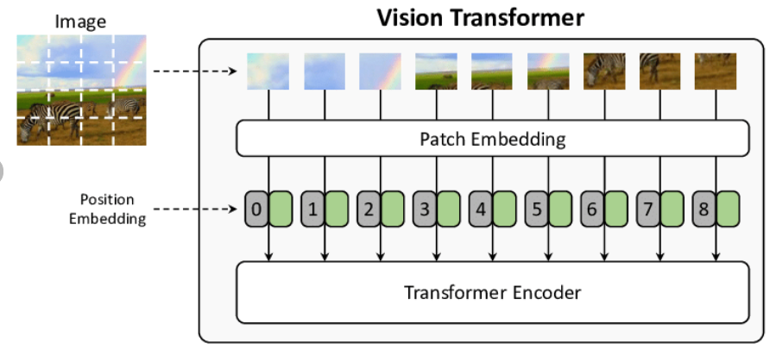
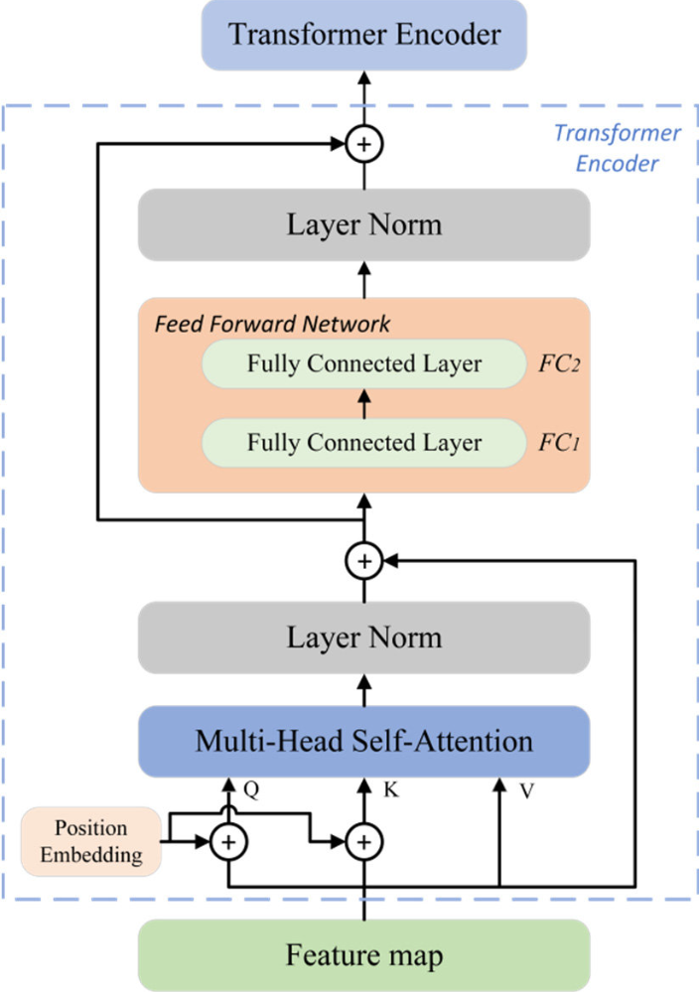
Algorithm:
Patching the Image:
Embedding and Positional Encoding:
Transformer Encoder Blocks:

Slide 9
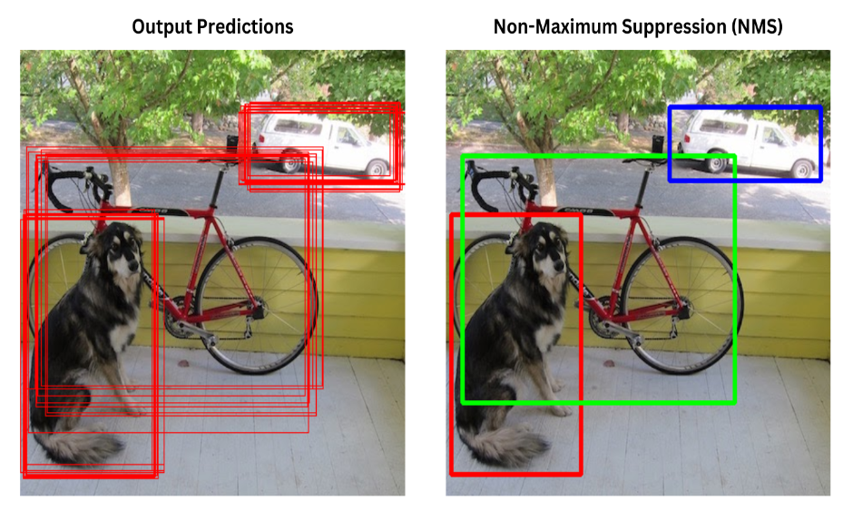
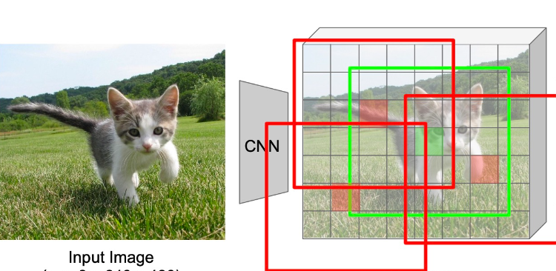
Feature map:
A feature map is the output of the transformer encoder blocks applied to image patches. It represents learned spatial hierarchies and is used for subsequent tasks like bounding box prediction and class recognition.
Post-Processing:
Non-Maximum Suppression (NMS):
Region Proposal Networks (RPNs) :
ROI (Region of Interest) pooling:
The output of RPN module, are pooled into a consistent size, ensuring alignment for subsequent processing and classification tasks.

Slide 10
Model Architecture:
Input size: 224*224*3.
Number of heads: 8.
Number of transformer layers: 4.
Embedding dimension: 768.
Multi-layer perceptron size: 2048.
MLP dropout: 0.1, 0.3.
Attention dropout: 0.1, 0.2.
Embedding dropout:0.1, 0.3.
Patch size: 16.
Optimiser: AdamW, Adam
Weight decay:0.001, 0.0001
learning_rate = 1e-4, 1e-3
Cosine Annealing learning rate : min=1e-5,1e-4.

Slide 11
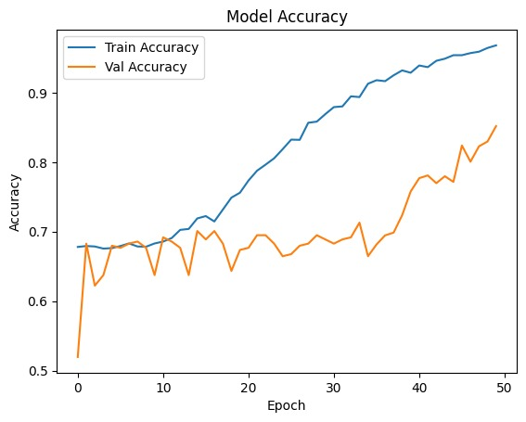
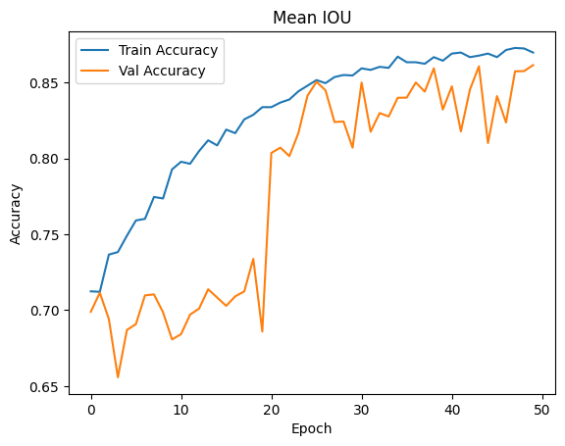
Result Analysis: Accuracy
Classification accuracy

Slide 12
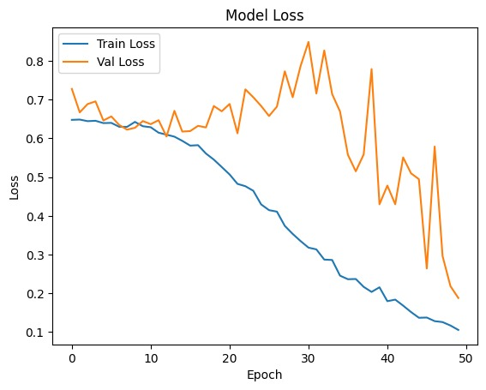
Results Analysis: Loss
Loss=BCE + MSE

Slide 13
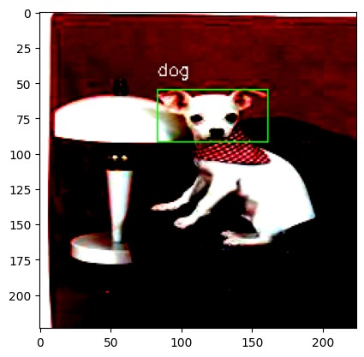
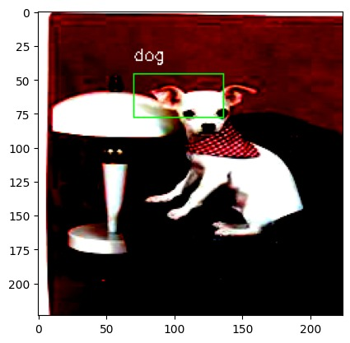
Results:
Ground Truth
Predicted

Slide 14
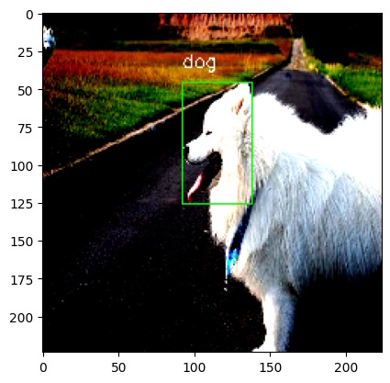
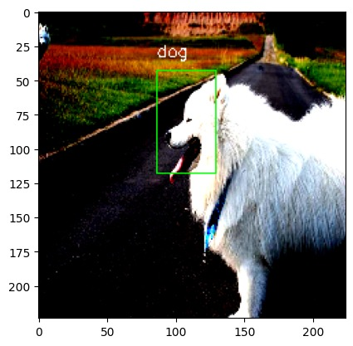
Results:
Ground Truth
Predicted

Slide 15
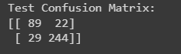
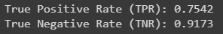
Metrics for Classification: Confusion Matrix
TPR, TNR

Slide 16


